Slide 1
The R environment and the Three C’s
R in Insurance 2016
Persuasive Advice for Senior Management

Slide 2
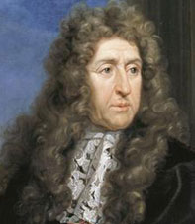
André Le Nôtre, The Gardens of Versailles
Notes:
Says André Le Nôtre, King Louis XIV’s landscaper of Versailles

Slide 3
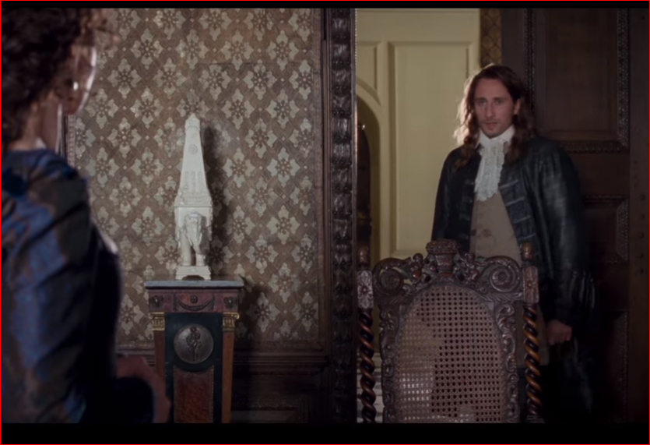
“I’m a Builder, Madame” André Le Nôtre, A Little Chaos, 2014
Notes:
Says André Le Nôtre, King Louis XIV’s landscaper of Versailles
A story about a woman passionate about her work, a man who risked trust in her non-traditional ways, and a king whose concern his family’s unhealthy environment in Paris led to the Palace’s construction

Slide 4
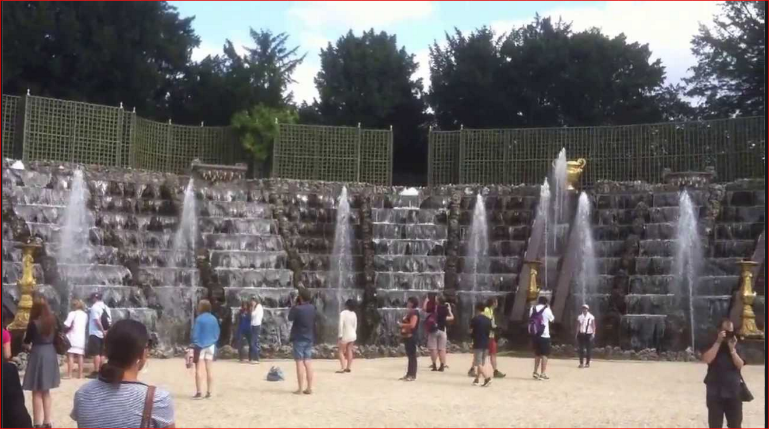
“I must confess to being a clay kicker myself” Sabine de Barra, fictional protégé of Le Nôtre
Notes:
So says the fictional Sabine de Barra, protégé of André Le Nôtre, King Louis XIV’s landscaper of Versailles Salle de Bal at Versailles
A Little Chaos
A couple of years ago, average reviews (44% rotten tomatoes)
A story about the Gardens of Versailles
A story about collaboration between two “builders” who were passionate about their work.
A story about a man who trusted in the skills of his protégé despite her so-called unconventional methods.
A story about a king who gave his Chief Gardener some independence to follow his vision despite not being able to embrace that vision himself.
A story about a woman passionate about her work, a man who risked trust in her non-traditional ways, and a king whose concern his family’s unhealthy environment in Paris led to the Palace’s construction
http://www.telegraph.co.uk/culture/film/11542992/A-Little-Chaos-who-was-Andre-Le-Notre.html
When Louis ennobled him in 1675, he was asked what he would like on his coat of arms. He replied: "Three snails and a head of cabbage - but I must not forget my spade, for it is due to my spade that I am the recipient of all the kindness with which your Majesty honours me."

Slide 5
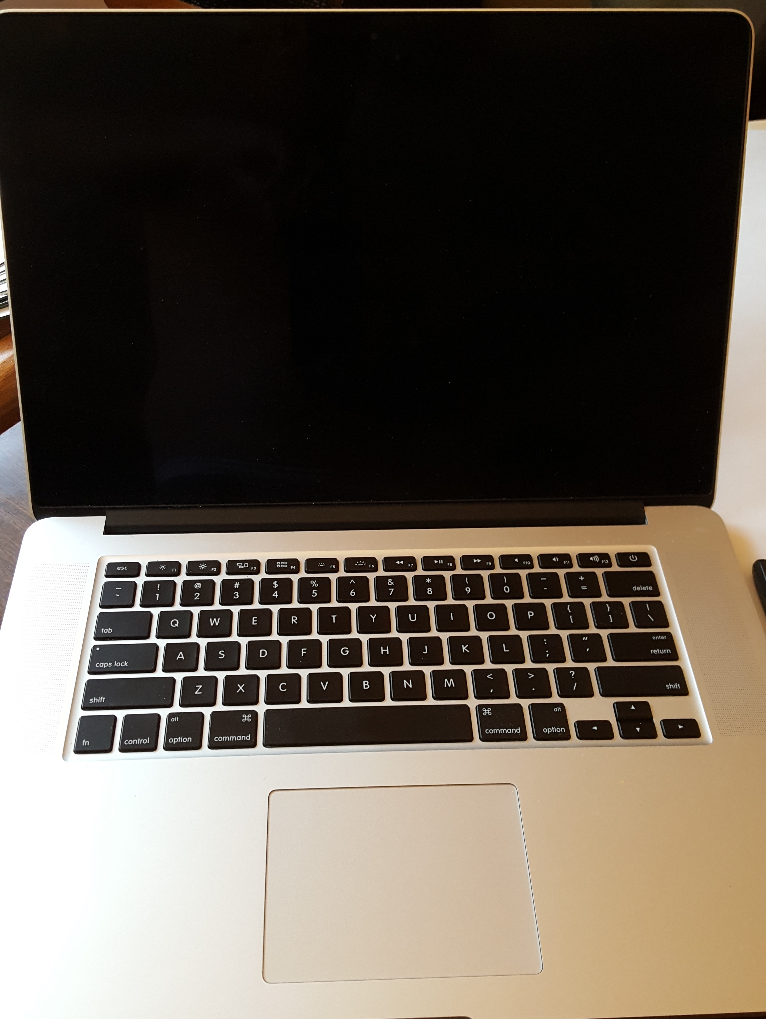
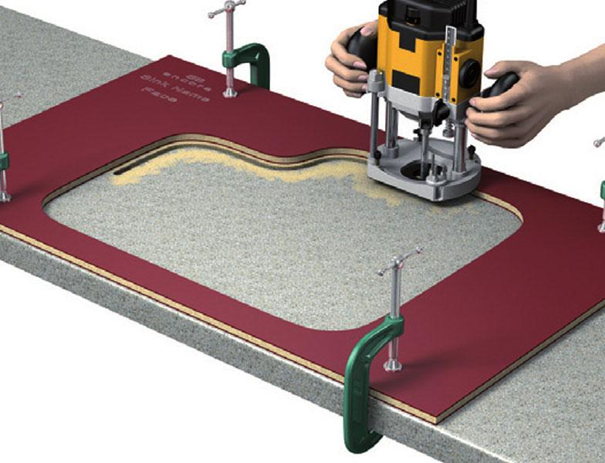
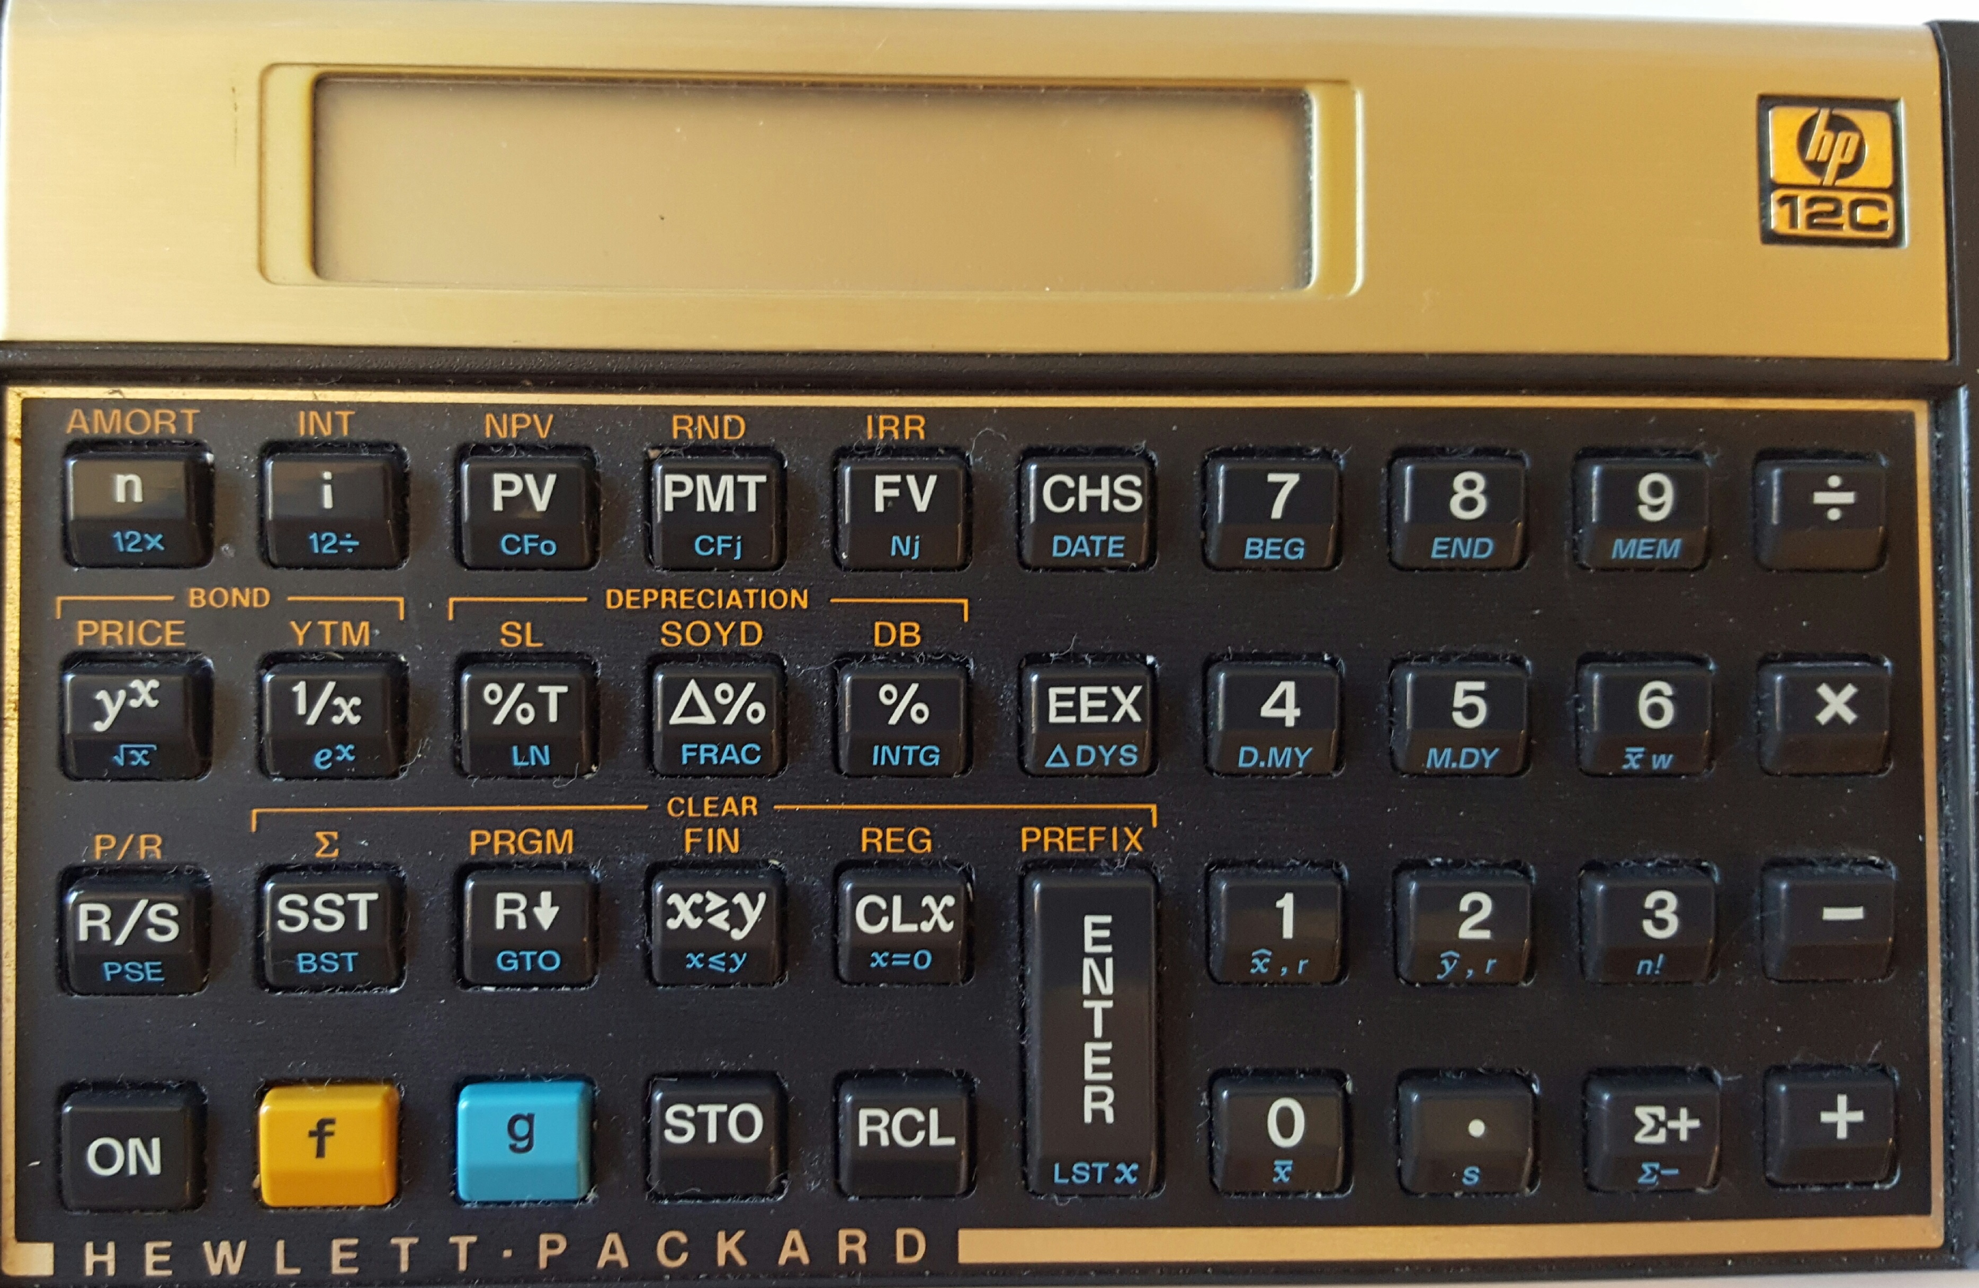
Builders use tools
A handheld device that aids in accomplishing a task
An apparatus used in the practice of a vocation or profession
A jig
Notes:
http://www.merriam-webster.com/dictionary/tool for first two
http://www.urbandictionary.com/define.php?term=tool

Slide 6
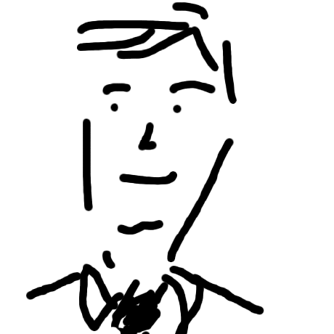
The “R Environment” is a collection of tools for the builder analyst

Slide 7
“Selling” Analysis to Senior Management
Three C’s to increase one’s persuasiveness
Context
Can you articulate the problem?
Confidence
Can you deliver your solution with conviction?
Clarity
Is your message actionable?

Slide 8
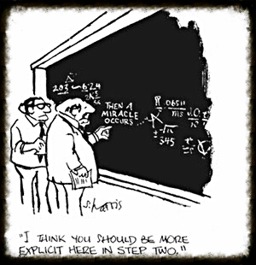
Context
A Definition: “The circumstances that form the setting for an event, statement, or idea, and in terms of which it can be fully understood and assessed”
Spreadsheets can quickly prototype an event, statement, or idea
One off’s vs repetitive analyses
Language
Does your tool conform to International standards
Documentation and reproducible research
Rmarkdown
Notes:
in terms of which it can be fully understood and assessed
Sometimes so for stochastic analysis too
Example: Emmanuel Bardis’ Mack Method spreadsheet vs. ChainLadder package’s MackChainLadder

Slide 9
Context: examples
Identify the ambiguous term(s) in the following sentence:
The value of incurred loss as of 2015-12-31 is ₤1 million
The ‘mondate’ package (on CRAN) is a “jig”
As-of dates
Date arithmetic in units of months
We all speak a different language … sometimes even when we are speaking the same language
Notes:
(Matt Dowle story – can you make a u turn here)

Slide 10
Tool for the context: code vs. spreadsheets
 | Spreadsheet | R script
Mock-up speed
What is it doing?
But base R code can be intimidating!
Actuary: If I wanted to be a programmer I would have gone into computer science!
More R packages for insurance are needed

Slide 11
Sabine de Barra advises the King
Delivered in context in the form of an allegory
Notes:
Matt Dowle story – can you make a u turn here

Slide 12
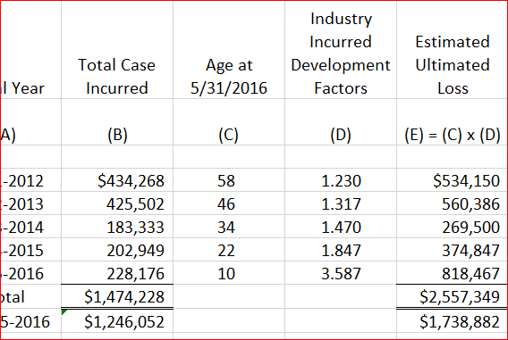
Confidence: Are you sure that …
Your calculations are correct?
Spreadsheet “formula bust”
Tech checkers
Program “bug”
Unit tests
Your data is correct?
Clean data can be highly rewarding
Subject matter expertise
Your results are correct?
Peer review
Collaboration

Slide 13
Confidence: data cleansing examples
Policies
w <- which(duplicated(policy_key))
w <- which(policyExpirationDate <= policyEffectiveDate)
Claims
w <- which(duplicated(claim_key)
Policies and Claims
pc <- join(claimTable, policyTable, by = "policy_key", type = "left")
with(pc, …
w <- which(is.na(policyNumber))
w <- which(claimDate < policyEffectiveDate)
w <- which(claimDate >= policyExpirationDate)

Slide 14
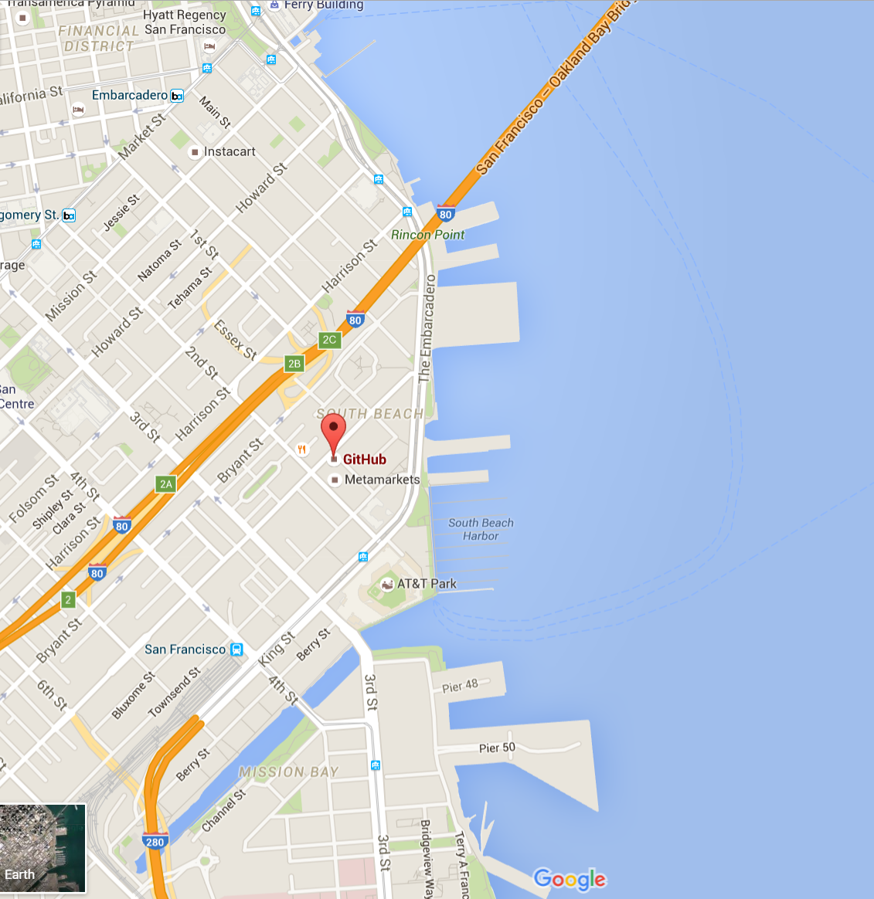
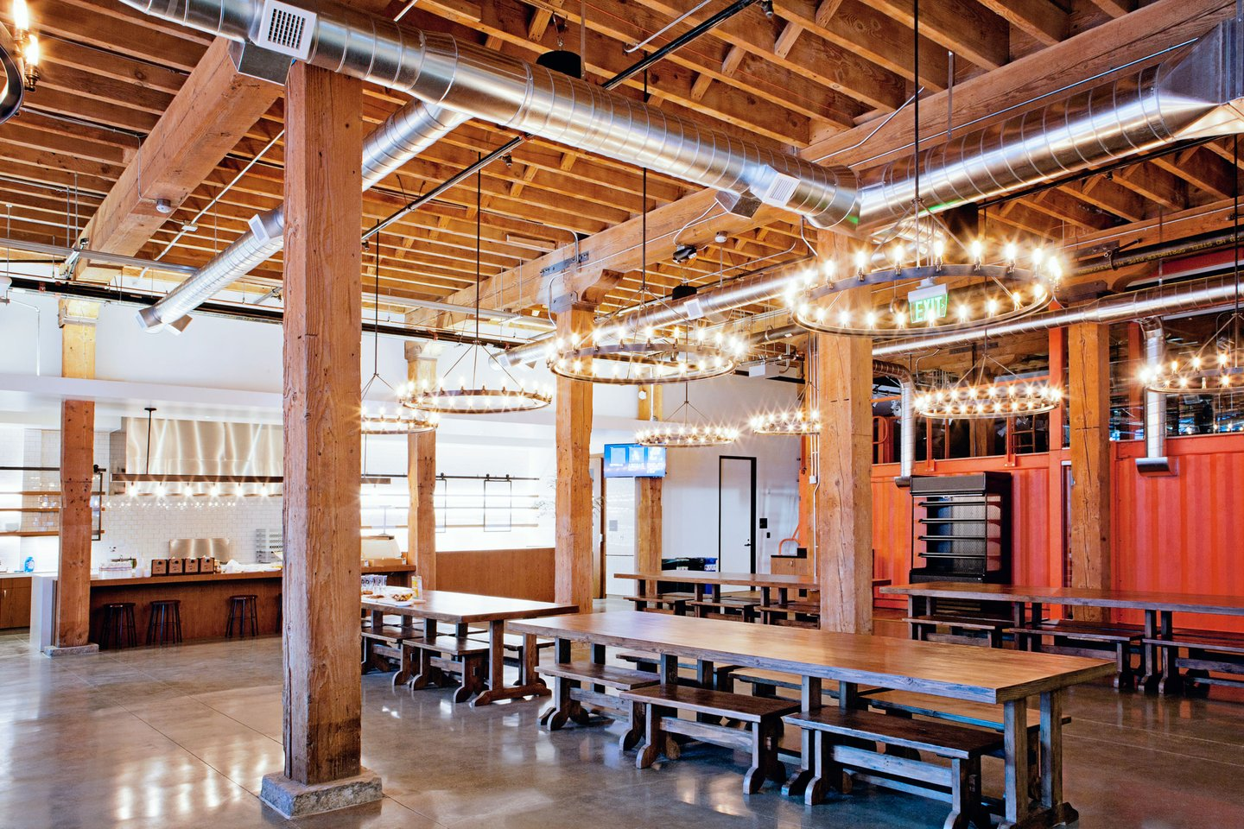
Collaboration increases confidence: Github
Github

Slide 15
Clarity: Actionable Analysis
Actuarial Standards of Practice
Management always asks “What if …?”
Higher resolution increases clarity
Visuals aid clarity
Notes:
Consistent results by country, line of business, other break-downs
M&A example: What if you jettison the unprofitable policies?
Reinsurance purchasing example: restate history

Slide 16
Clarity: ASOP 41
In the actuarial report, the actuary should state the actuarial findings, and identify the methods, procedures, assumptions, and data used by the actuary with sufficient clarity that another actuary qualified in the same practice area could make an objective appraisal of the reasonableness of the actuary’s work as presented in the actuarial report.

Slide 17
Clarity: What If …
Notes:
Consistent results by country, line of business, other break-downs
M&A example: What if you jettison the unprofitable policies?
Reinsurance purchasing example: restate history

Slide 18
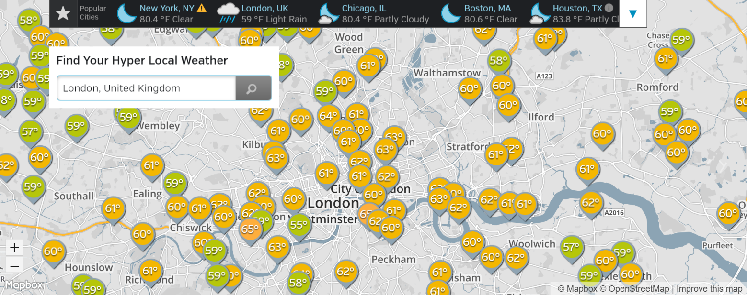
Clarity: Detailed vs Accumulated data The Weather Underground
Brian Fannin: https://github.com/PirateGrunt/CLRS2016 Jim Guszcza, Jan Lennele, Loss Reserving Using Claim Level Data

Slide 19
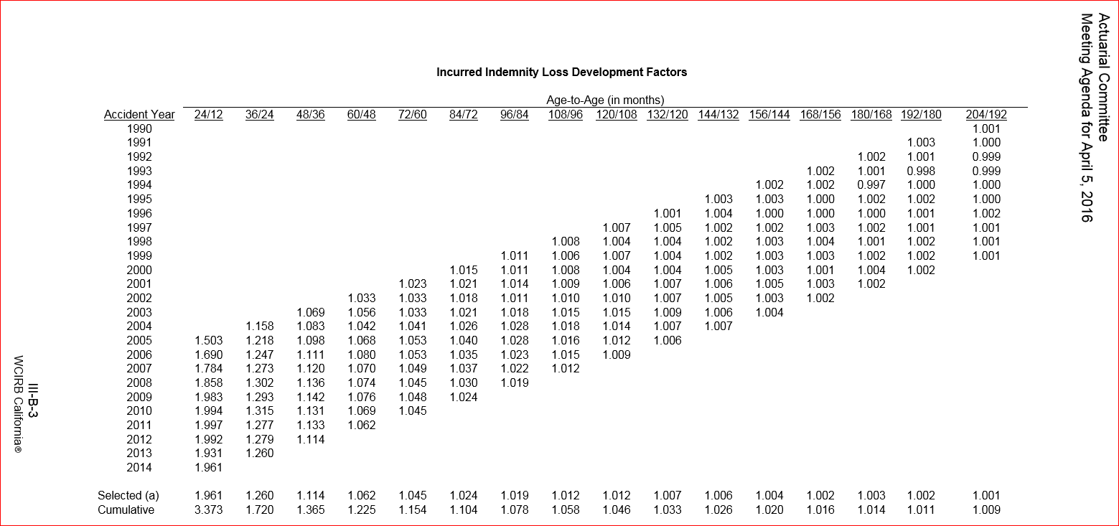
Interpolating LDFs California Workers Comp loss development factors

Slide 20
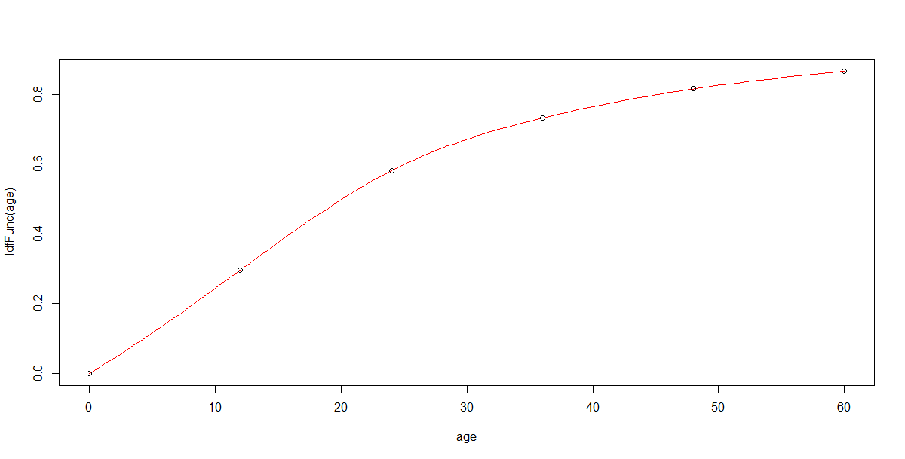
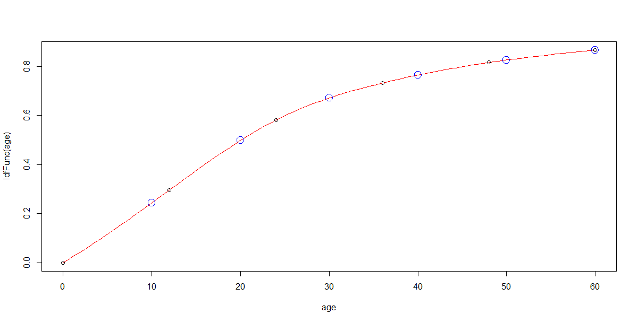
Interpolating LDF’s (cont.)
ldfFunc <- splinefun(seq(0, 60, by = 12), c(0, 1/3.373, 1/1.72, 1/1.365, 1/1.225, 1/1.154))
x <- seq(10, 60, by = 10)
y <- ldfFunc(x)
points(x, y, col = "blue", cex = 2)

Slide 21
“Bell Curves”

Slide 22
I must confess to being a clay kicker myself
Thank you for having me!
Dan Murphy
Trinostics LLC San Francisco

Slide 23
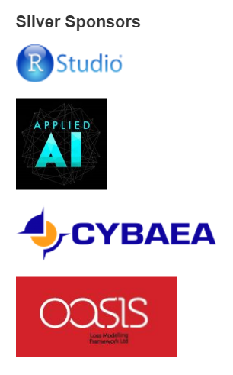
A big thank you to the sponsors!

